Slide 1

CMU Portugal
Advanced Training Program
Multimodal Conversational AI and Generative AI
JOÃO MAGALHÃES
NOVA SCHOOL OF SCIENCE AND TECHNOLOGY
VASCO RAMOS
NOVA SCHOOL OF SCIENCE AND TECHNOLOGY
BRUNO MARTINS
INSTITUTO SUPERIOR TÉCNICO

Slide 2



Large Language Models (LLMs)
What is a LLM?
A category of foundation models trained on extremely vast datasets in order to make them capable of understanding and generating natural language content.
LLMs can generate human-like responses based on context
Question-Answering
Translation
Text Summarization
2

Slide 3
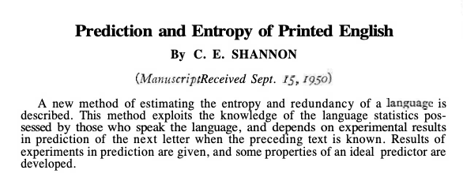
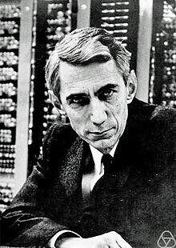
Language Modeling: The Concept
Definition: A probabilistic approach that involves predicting the next word, in a sequence of words or sentence, based on the context and previous words.
3
“Pre-train once, fine-tune many times” paradigm
These models can handle multiple NLP tasks such as translation, summarization, and question answering.

Slide 4
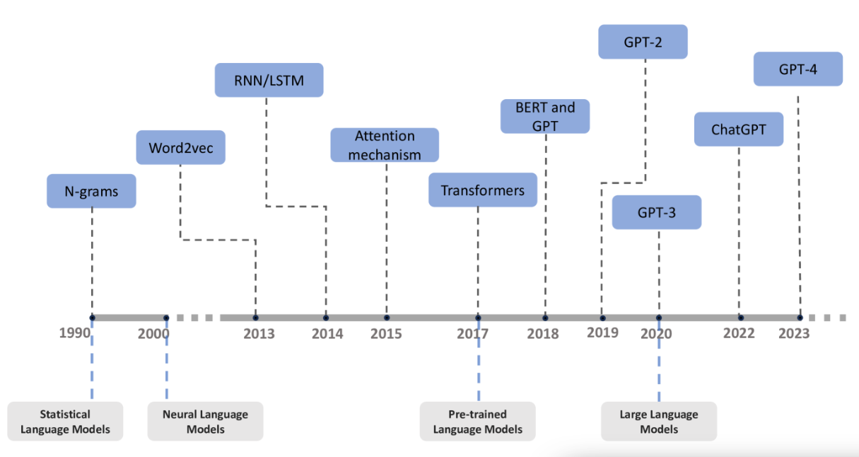
Language Modeling: The Concept
Definition: A probabilistic approach that involves predicting the next word, in a sequence of words or sentence, based on the context and previous words.
Large Language Models
Language Models
4
“Pre-train once, fine-tune many times” paradigm
These models can handle multiple NLP tasks such as translation, summarization, and question answering.

Slide 5


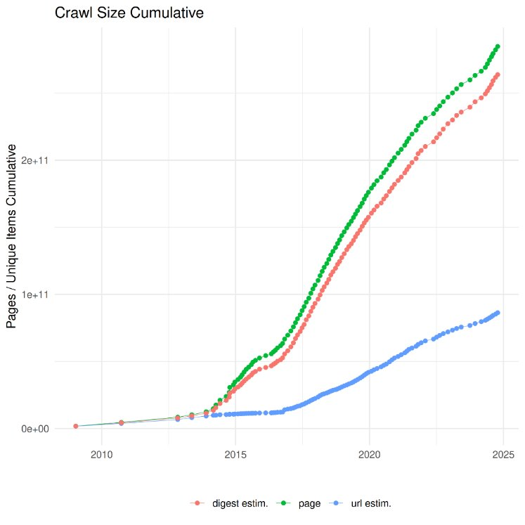


What made these models Large Language Models?
More Data!
Computer Power
LLMs require massive GPUs/TPUs and distributed computing
More Parameters
From millions (BERT) to trillions (GPT-4) of parameters
Architecture
Transformers (...with many tweaks...)
5

Slide 6
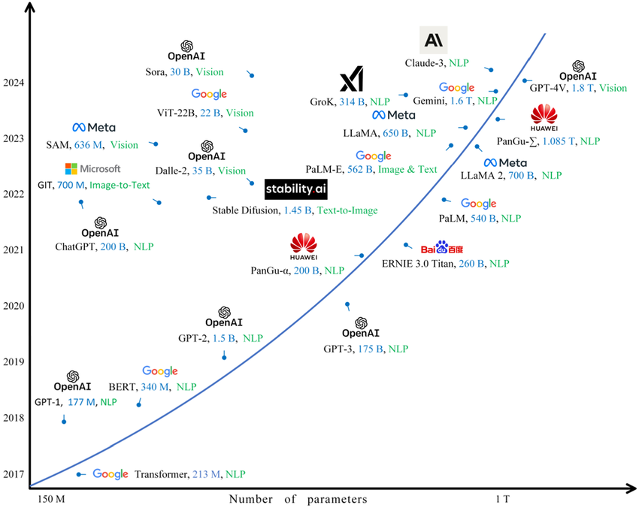
What makes these models Large Language Models?
We are (still, but...) witnessing an exponential growth in model size and compute!
More parameters and more (train/test) compute
Fluency, reasoning, and overall generalization
Costs
The current frontier involves multimodal LLMs, reasoning, and tool use.
6

Slide 7

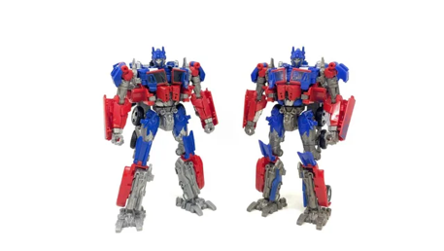
The Transformer Architecture and Neural Attention
We want “neural networks” that automatically weight input relevance when making predictions (i.e., models that “attend” to inputs)
Which parts of an input sequence are more important for the current prediction
Main advantages over other alternatives
Intuitive relation with “human attention”
Performance gains
Few parameters (for individual attention operations)
Easy to parallelize
Mechanism for interpreting predictions
Implicit alignment or anaphora resolution
7

Slide 8
Let’s Recap the Transformer Encoder
Tokenization
Input Embeddings
Position Embeddings
Query, Key & Value
Attention
Self-Attention
Multi-Head Attention
Feed Forward
Add & Norm
Encoder Layers
8

Slide 9
Tokenization
Embedding Layer
Just
do
it
<eos>
Tokenizer (split into individual words)
Just do it
9

Slide 10
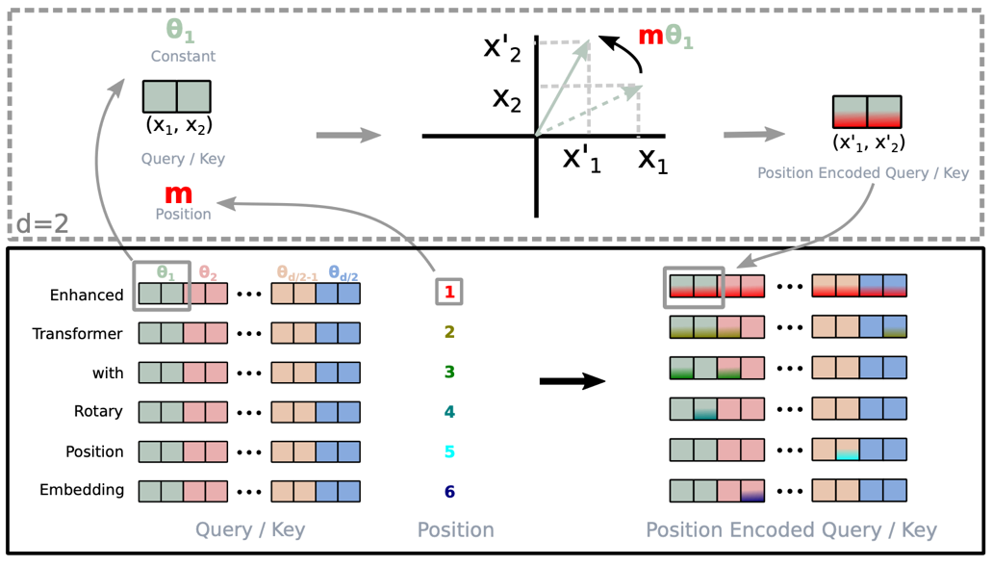
Positional Encodings
Several alternatives have been tested
Static sinusoidal embeddings
From the original Transformer model
Low variance at higher dimensions
Learned embeddings
Provide absolute position encoding
Relative position embeddings
Values relating positions of queries and keys
Rotary position embeddings (RoPE)
Rotate the vectors by amount of angle multiples of the position index
The dot product gradually diminishes with distance
RoPE was proposed for RoFormer and is now used in most state-of-the-art models!
10

Slide 11
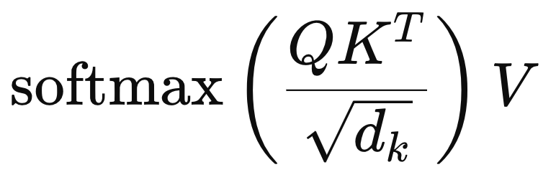
Self-Attention
X
X
W_{K}
W_{V}
K
X
Attention Weights
Q
V
W_{Q}
11

Slide 12
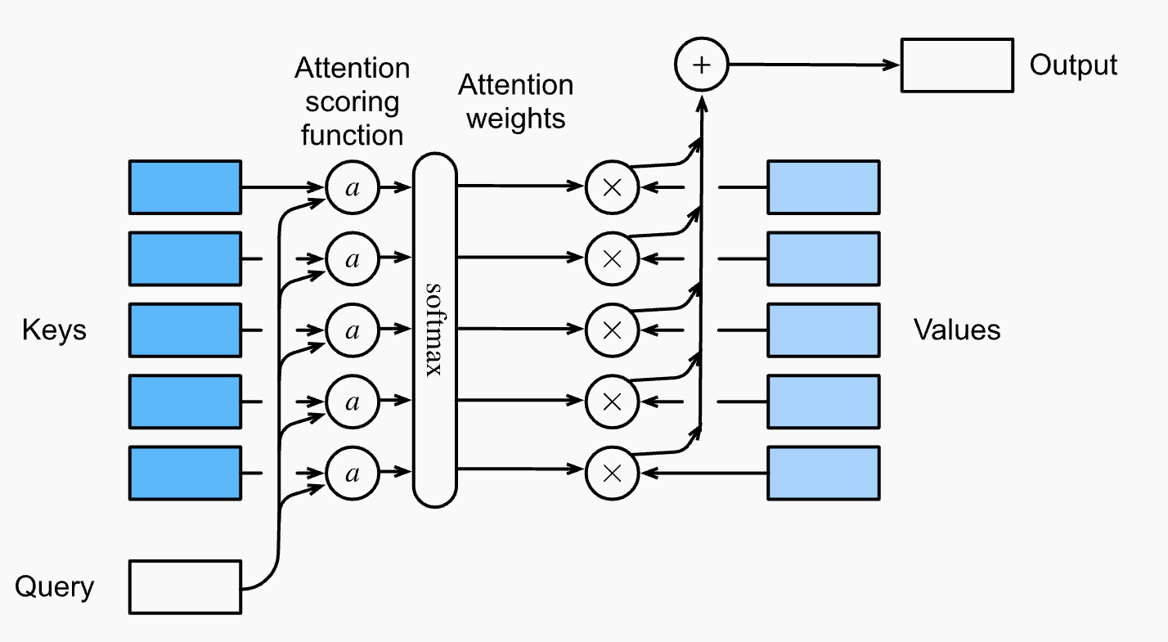
12

Slide 13
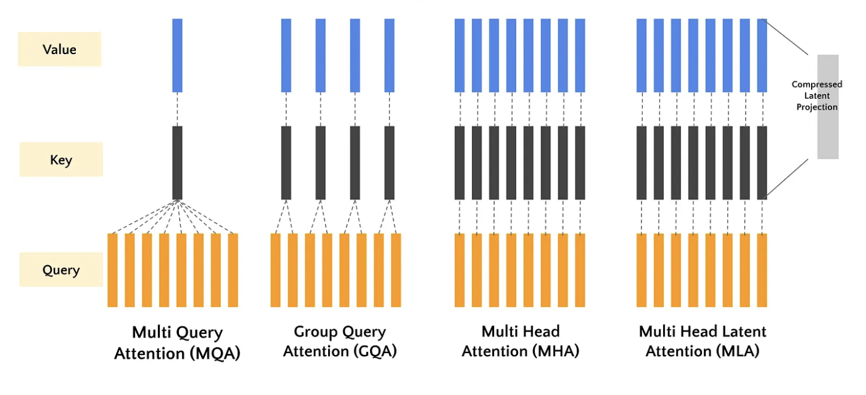
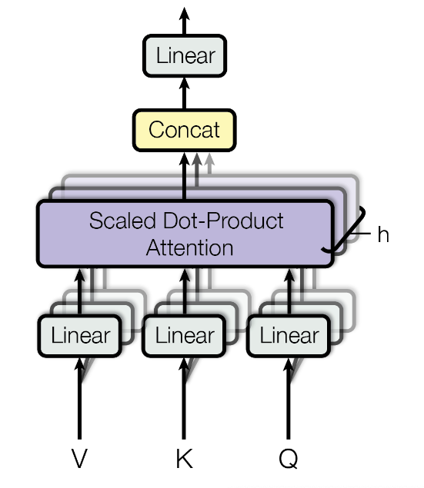
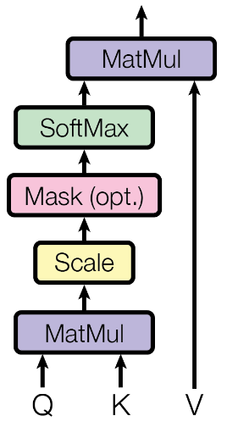
Multi-Head Attention and More Efficient Variations
13

Slide 14
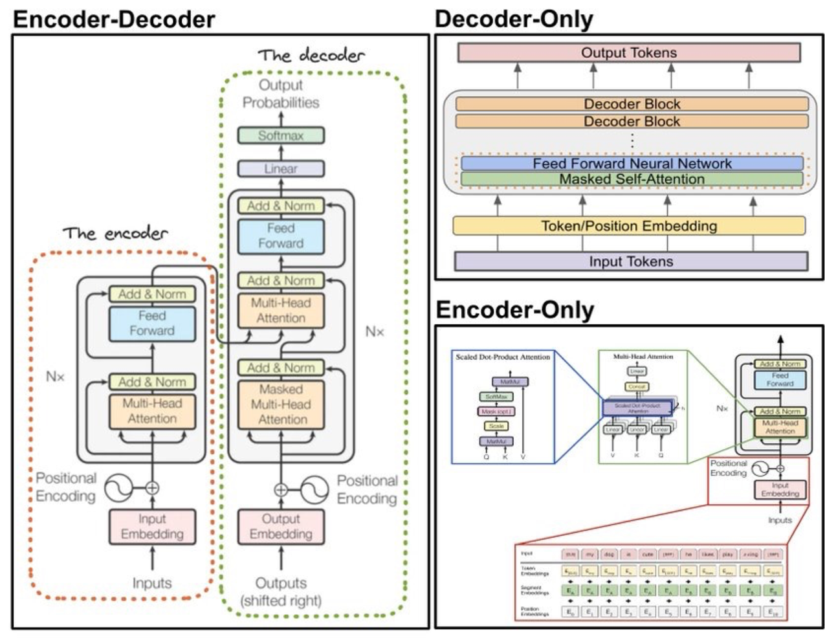
Different Transformers
Encoder-Decoder Models
Original Proposal, T5, BART
Gemma T5 2
Encoder Models
BERT, RoBERTa, …
ModernBERT
Decoder Models
GPT-2 and most modern LLMs
14

Slide 15
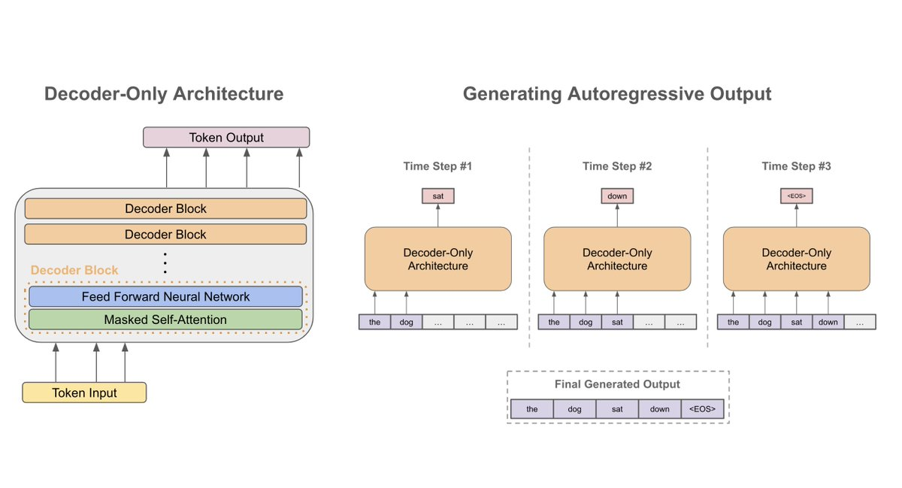
Large Language Models (LLMs)
15

Slide 16
Overview
Introduction
Transformer-Based Encoder-Decoder Models
Decoder-Only Transformers and LLMs
More Details on Language Decoding
Strategies and Software for Using LLMs
Exercises
16

Slide 17
The Decoder
Tokenization
Input Embeddings
Position Embeddings
Query, Key & Value
Masked Attention
Cross Attention
Linear Projection Layer
Softmax
17

Slide 18
Tokenization
Embedding Layer
Just
do
it
<eos>
Tokenizer (split into individual words)
Just do it
18

Slide 19
Self-Attention
Just
do
it
<eos>
Just
do
it
<eos>
Just
do
it
<eos>
Just
do
it
<eos>
19

Slide 20
Masked Self-Attention (1)
Ensures that predictions only depend on the past and not future tokens (support unbounded length, caching, etc.)
Just
do
it
<eos>
Just
do
it
<eos>
Just
do
it
<eos>
Just
do
it
<eos>
20

Slide 21
Masked Self Attention (2)
We need to mask the future outputs
Just
do
it
<eos>
Just
do
it
<eos>
Just
do
it
<eos>
Just
do
it
<eos>
21

Slide 22
Masked Self Attention (3)
We need to mask the future outputs
Just
-∞
-∞
-∞
Just
do
-∞
-∞
Just
do
it
-∞
Just
do
it
<eos>
22

Slide 23
Masked Self Attention (4)
1
-∞
-∞
-∞
1
1
-∞
-∞
1
1
1
-∞
1
1
1
1
Just
do
it
<eos>
Just
do
it
<eos>
Just
do
it
<eos>
Just
do
it
<eos>
23

Slide 24
Masked Self Attention (5)
Why -∞?
Since we need to normalize the values and we do not want those “future” tokens to have influence in the prediction, we use the minus infinite because the softmax will output a probability of 0 on those positions.
24

Slide 25
Masked Self Attention (6)
Why -∞?
Since we need to normalize the values and we do not want those “future” tokens to have influence in the prediction, we use the minus infinite because the softmax will output a probability of 0 on those positions.
25

Slide 26
Masked Self Attention (7)
X
X
W_{K}
W_{V}
K
X
Masked Attention Weights
Q
V
W_{Q}
26

Slide 27
The Decoder
Tokenization
Input Embeddings
Position Embeddings
Query, Key & Value
Masked Attention
Cross Attention
Linear Projection Layer
Softmax
27

Slide 28

28

Slide 29
Combining Encoder and Decoder: Multiple Attentions
Encoder Self Attention
Queries from Encoder Inputs
Keys from Encoder Inputs
Values from Encoder Inputs
Decoder Masked Self Attention
Queries from Decoder Inputs
Keys from Decoder Inputs
Values from Decoder Inputs
Use Cross-Attention to combine both types of information!
29

Slide 30
Cross-Attention (1)
Cross-attention is a mechanism where one sequence (e.g., in the decoder) attends to another sequence (e.g., the encoder output).
Queries from Decoder Inputs
Keys from Encoder Outputs
Values from Encoder Outputs
It allows the decoder to incorporate relevant information from the encoder output when generating tokens.
30

Slide 31
Cross-Attention (2)
Inputs:
Query (Q): Comes from the current layer in the decoder.
Keys (K) and Values (V): Come from the final outputs of the encoder.
The decoder’s queries attend to the encoder’s keys/values to determine which parts of the encoded input should influence the current token generation.
This helps in contextualizing the output generation based on the encoded input sequence.
31

Slide 32
Predicting the next token (1)
We have a hidden representation of the sequence
Hidden Representation
(Output of Encoder)
32

Slide 33
Predicting the next token (2)
We have a Matrix d_{model} x Vocabulary
Each row represents one entry of the vocabulary with the embedding dimension
Hidden Representation
(Output of Encoder)
Vocabulary Matrix
33

Slide 34
Predicting the next token (3)
We take the product of both matrices
Hidden Representation
(Output of Encoder)
Vocabulary Matrix
34

Slide 35
Predicting the next token (4)
We then use softmax to have a probability of each word of the vocabulary being represented by the output of the encoder
Hidden Representation
(Output of Encoder)
Vocabulary Matrix
softmax
35

Slide 36
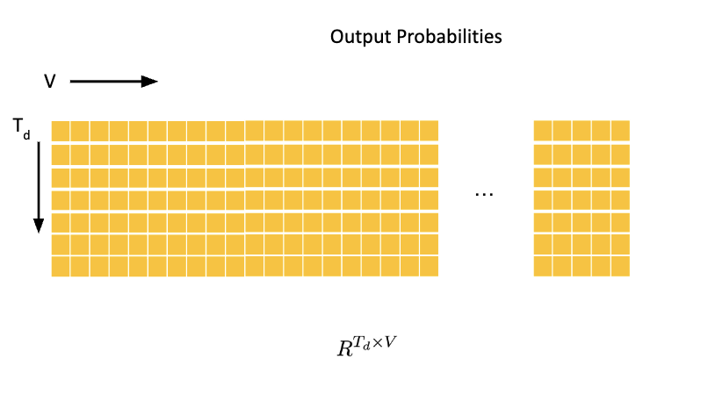
Predicting the next token (5)
Greedy aproach: Take word with highest probability.
36

Slide 37
Input - Input Tokens
Output - Hidden States
Model can see all the input tokens!
Input - Output tokens and hidden representations
Output - Output tokens
Model can only see previousl tokens!
Model is auto-regressive with
previous timesteps’ outputs.
Representation
Generation
37

Slide 38
Overview
Introduction
Transformer-Based Encoder-Decoder Models
Decoder-Only Transformers and LLMs
More Details on Language Decoding
Strategies and Software for Using LLMs
Exercises
38

Slide 39
BERT
OCT 2018
GPT
June 2018
Representation
Generation
39

Slide 40
GPT – Generative (General Purpose) Pretrained Transformer
Is it possible to use large amounts of unlabeled data to pretrain a LM, so it can understand general language patterns?
40

Slide 41
GPT: Pre-Training
GPT Pre-Training Corpus:
Big corpus of Web documents like Wikipedia
GPT Pre-Training Tasks:
Predict next token, given the previous token (recall idea from Claude Shannon)
it
GPT
<SOS>
Just
do
41

Slide 42
GPT: Model Fine-Tuning
Summarization:
Ask to summarize a certain amount of text
Question-Answering:
Ask to answer a question
Give context
Recent alternatives to full model fine-tuning: LoRA, QLoRA, ...
42

Slide 43
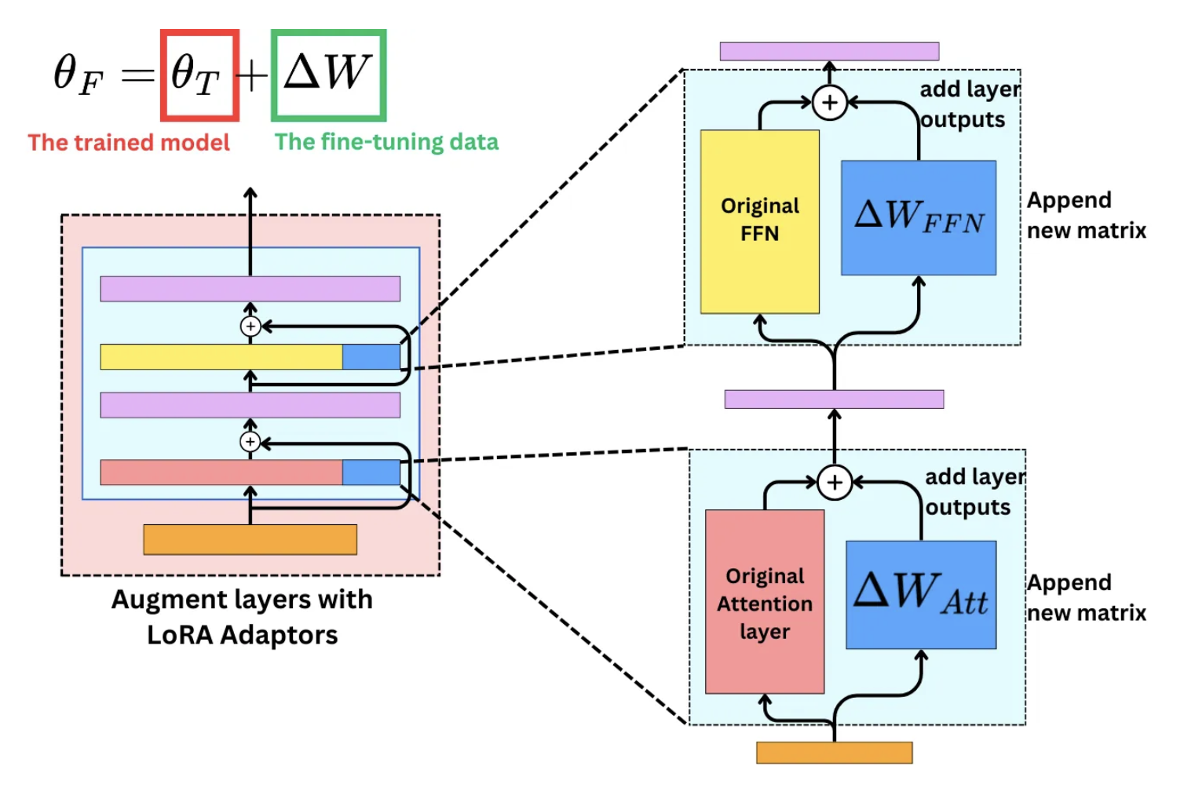
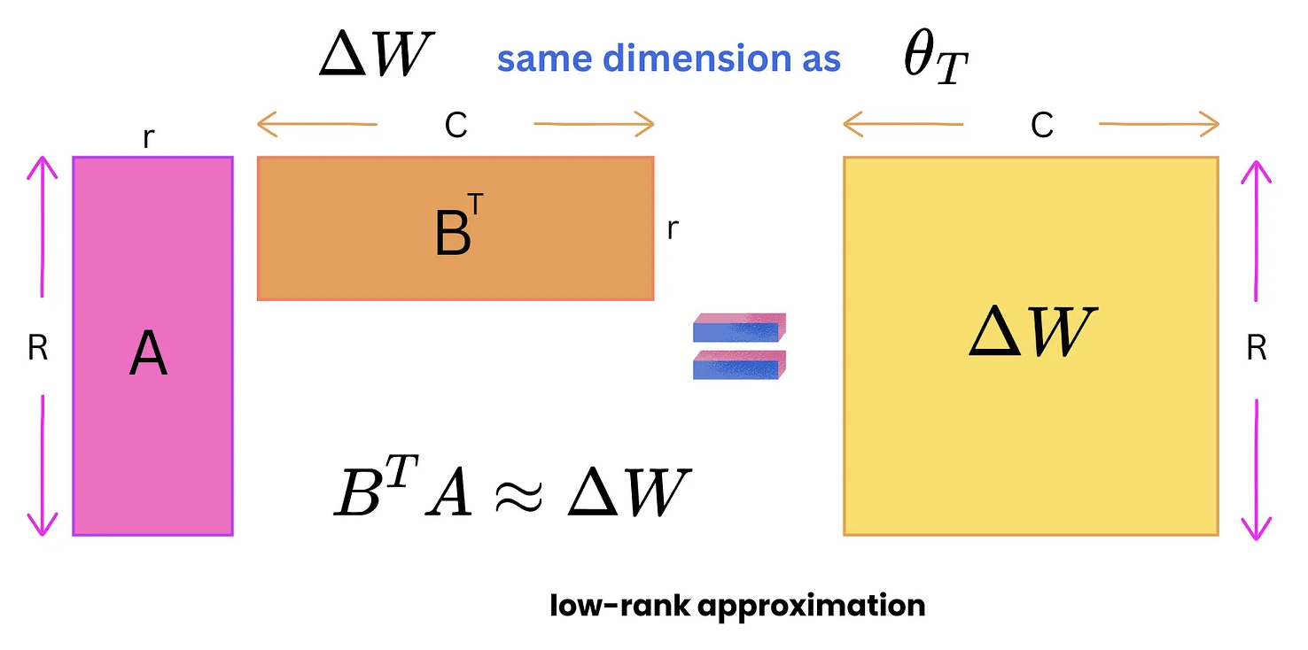
Parameter Efficient Fine-Tuning (PEFT)
43

Slide 44
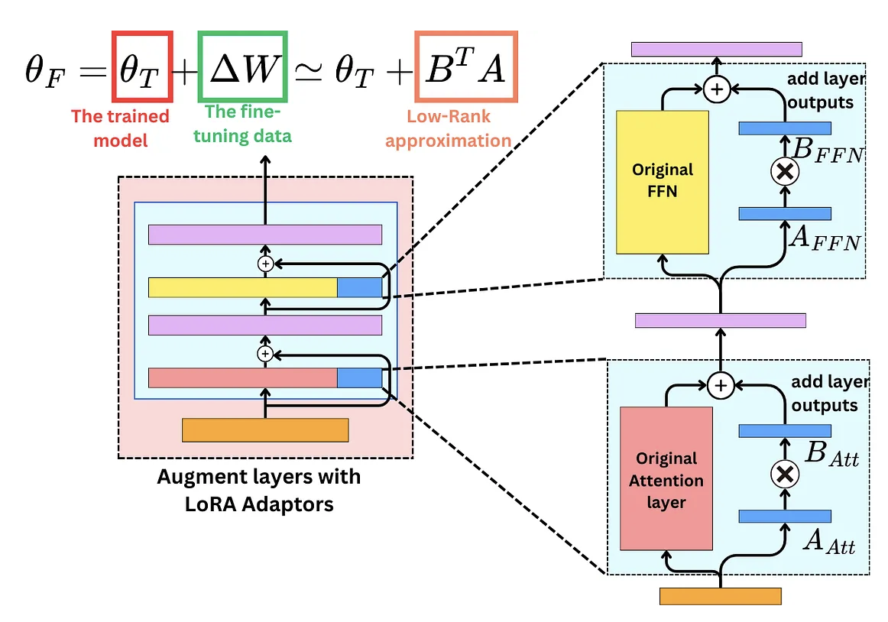
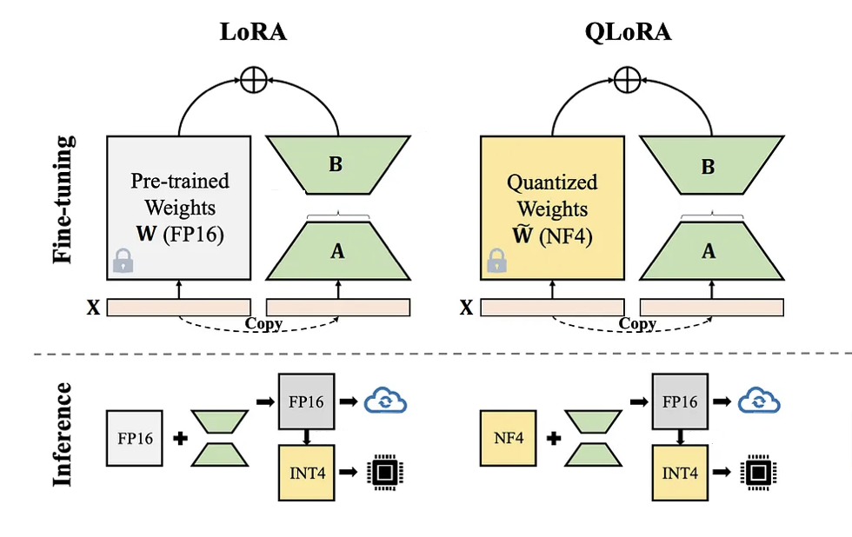
PEFT with LoRA and QLoRA
44

Slide 45
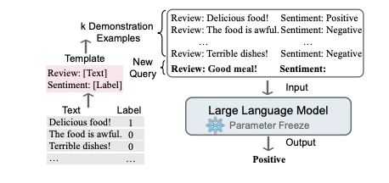
Larger GPT Models and In-Context Learning
Scaling model size (GPT-2 vs GPT-3) leads to emerging abilities:
Use in-context learning instead of model fine-tuning
45

Slide 46
From GPT-3 to ChatGPT and Beyond
Further training to interact in the form of a conversational dialogue, and provide human-like responses to instructions.
Finetuning large GPT model to human preferences over responses, with Reinforcement Learning from Human Feedback (RLHF).
Many extensions/simplifications over original proposal!
Architectural changes over the Transformer decoder architecture.
Alternative learning objectives for aligning models to human preferences
E.g., Direct Preference Optimization (DPO) instead of RLHF with PPO
E.g., Group Relative Policy Optimization (GRPO)
46

Slide 47
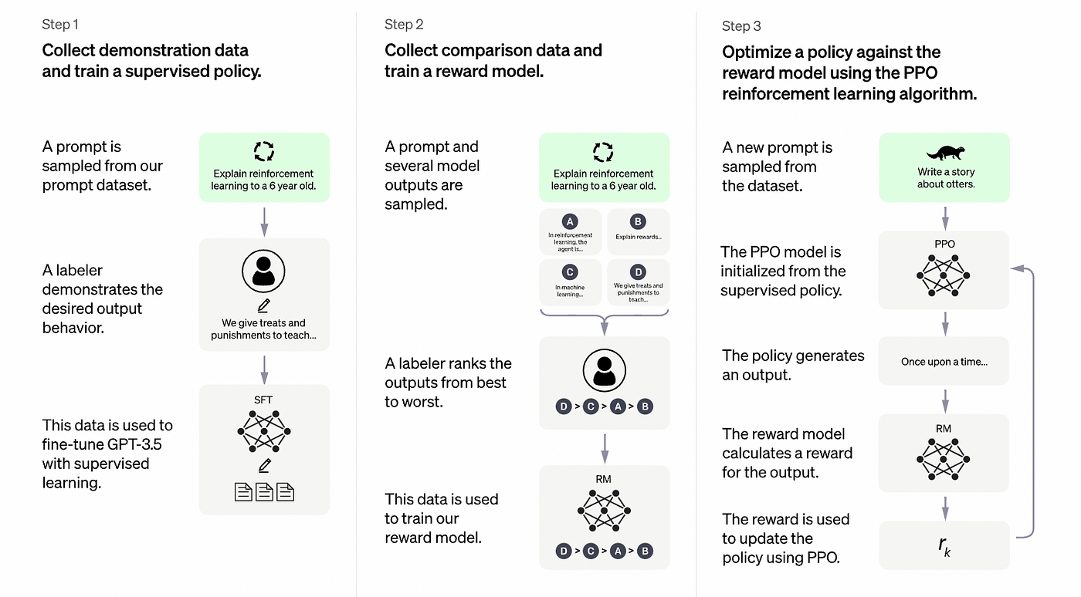
47

Slide 48
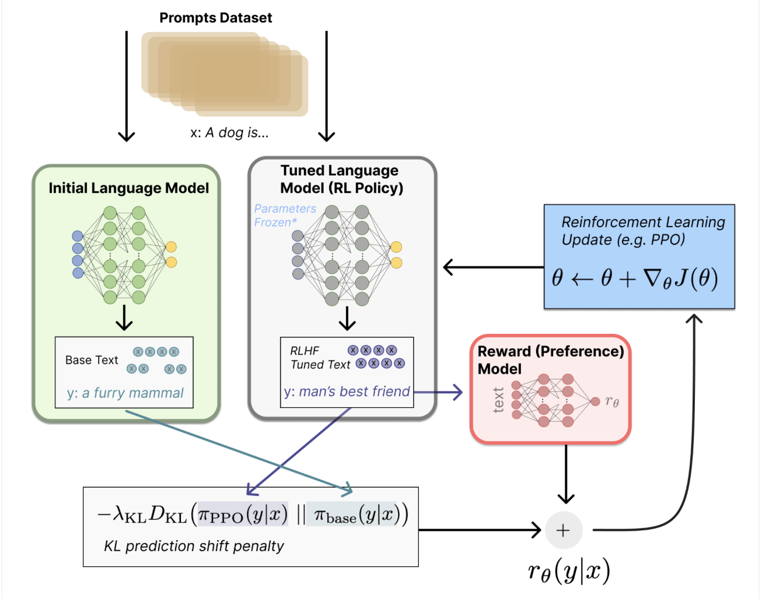
Reinforcement Learning from Human Feedback
RL policy is a language model that takes in a prompt and returns prob. distributions over text (state-action pairs)
The action space of this policy is all the tokens corresponding to the vocabulary of the language model
The state observation space is the distribution of possible input token sequences
The reward function is a combination of the preference model and a constraint on policy shift (e.g., based on KL divergence), computing advantage for a state-action pair
The update rule is the parameter update (e.g., from PPO) that maximizes the reward in the current batch of data
48

Slide 49
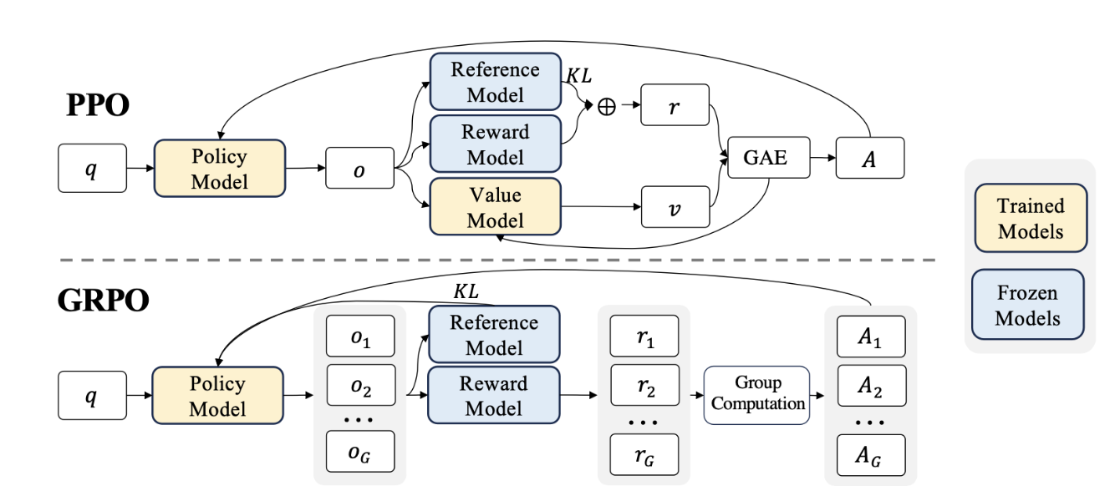
PPO versus GRPO
49

Slide 50
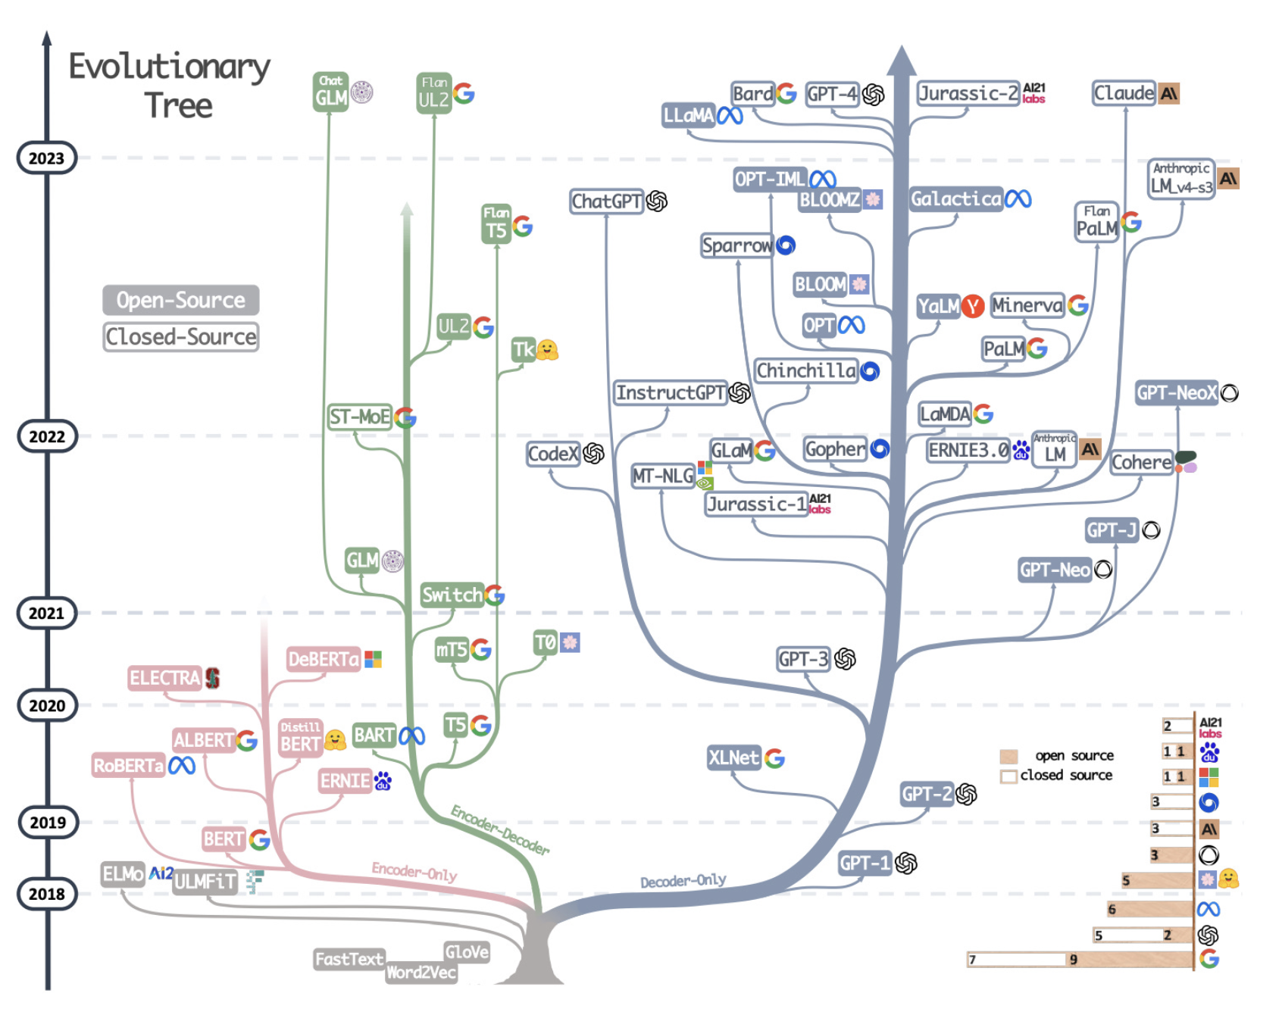
Many efforts (e.g., in the open-source community) to replicate ChatGPT
Developments have led to a distribution of interesting models
50

Slide 51
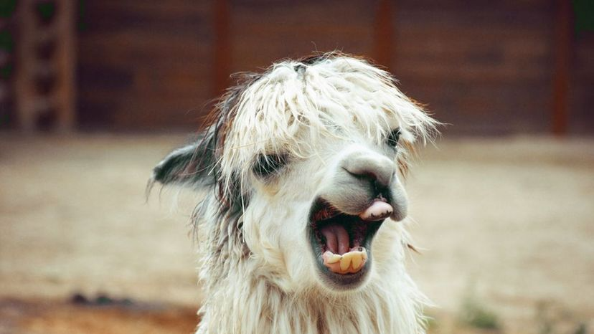
Many open-source alternatives
LLaMA (released on February 2023)
Openly replicate the capabilities of the commercial LLMs like GPT-3
Alpaca (2 weeks after LLaMA)
Synthetic instruction dataset created with ChatGPT, used to fine-tune LLaMA (supervised, instead of RL from inhuman feedback)
Vicuna (3 weeks after LLaMA)
Trained with user-shared conversations from ChatGPT, and evaluated with other LLMs (e.g., GPT4)
WizardLM (5 weeks after LLaMA)
Use other LLMs to create more challenging instruction datasets (i.e., rewrite instructions step by step into more complex ones)
Guancano (9 weeks after LLaMA)
Trained with cleaned/extended version of Alpaca, using LoRA and 4-bit quantization
Orca (14 weeks after LLaMA)
Trained with examples from GPT-4, including chain-of-thought examples
FalconLM (14 weeks after LLaMA)
Alternative to LLaMA, further finetuned on a mixture of chat/instruct datasets
Nous-Hermes (15 weeks after LLaMA)
Fine-tuning LLaMa with large instruction data, almost entirely synthetic GPT-4 outputs
51

Slide 52
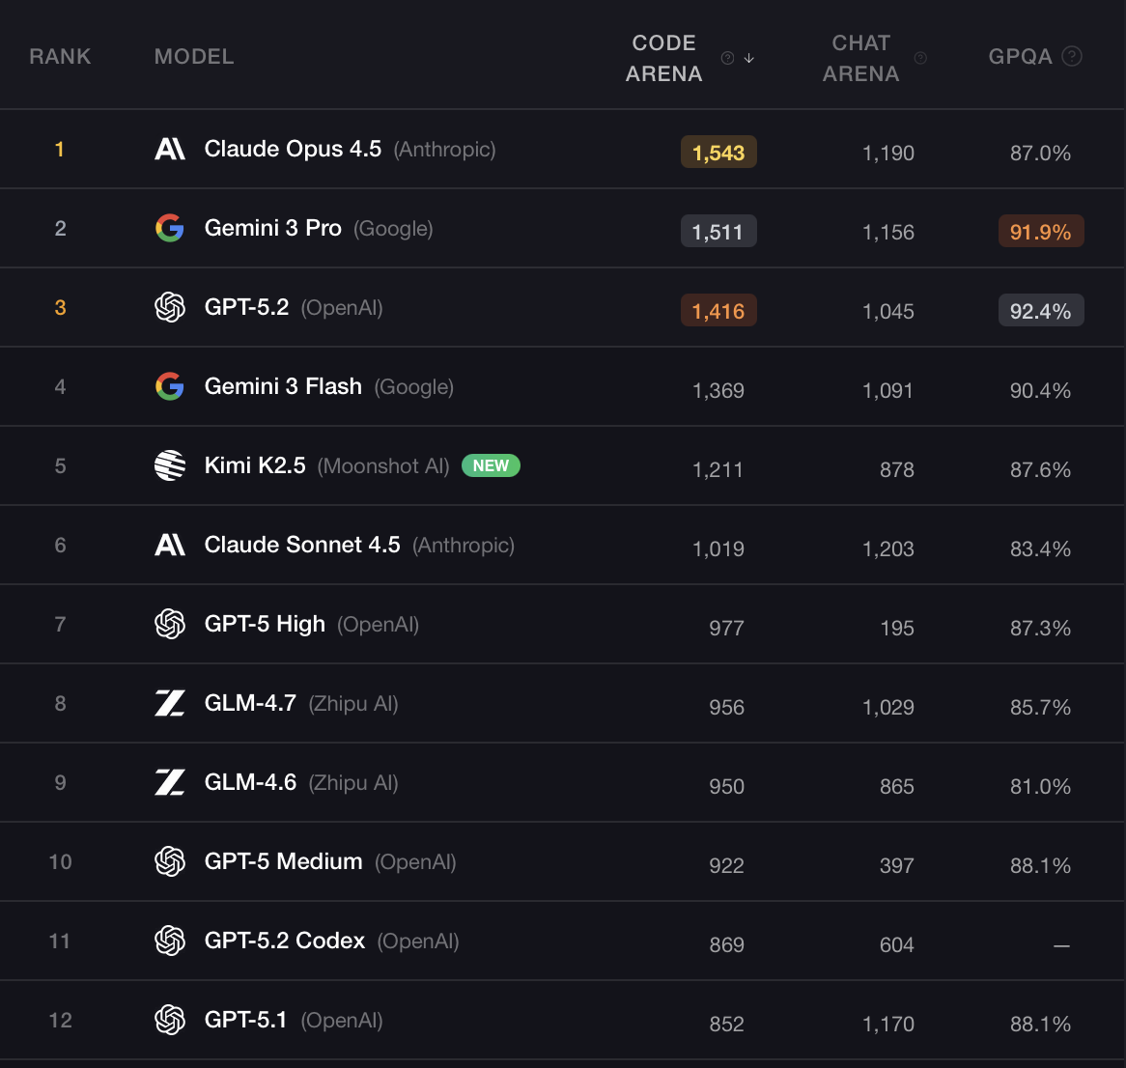
Even more recent open(ish) alternatives
Meta LLaMA
Google Gemma
Microsoft Phi-3, Phi-4, Orca, Orca-2, …
Alibaba Qwen
DeepSeek
Mistral, Falcon, OLMo, EuroLLM, …
Available in:
Different versions (e.g., fine-tuned to follow instructions)
Different sizes (e.g., 3B, 8B, 30B, 70B, 180B, 405B, 1T … parameters)
Different context lengths (e.g., 4K to 128K tokens)
Some are better with multilingual inputs
Evaluation results on public leaderboards
52

Slide 53


Exercise Time
https://huggingface.co/docs/transformers/en/llm_tutorial
https://huggingface.co/docs/transformers/en/model_doc/llama3
53

Slide 54
Overview
Introduction
Transformer-Based Encoder-Decoder Models
Decoder-Only Transformers and LLMs
More Details on Language Decoding
Strategies and Software for Using LLMs
Exercises
54

Slide 55
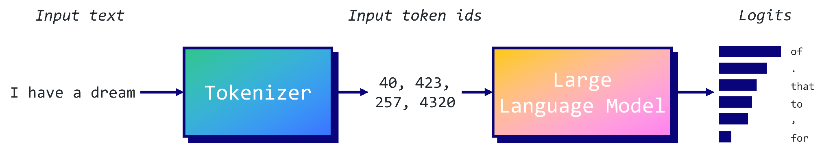
Common Text Decoding Strategies (1)
55

Slide 56
Common Text Decoding Strategies (2)
Greedy Search
Beam Search
Top-k Sampling
Sampling with Temperature
Nucleus (Top-n) Sampling
56

Slide 57
Decoding Strategies: Greedy Search
Greedy search takes the most probable token at each step as the next token in the sequence.
It only retains the most likely token at each stage, discarding all other potential options.
57

Slide 58
Decoding Strategies: Beam Search (1)
Beam Size (k): A hyperparameter that determines how many of the top candidate sequences are kept at each time step
Select the top k tokens with the highest predicted probabilities.
Subsequent Steps: For each of the k candidate sequences from the previous step, predict the next token.
Select the k most likely sequences from all possible continuations.
Repeat the process until the model generates the complete sequence or reaches a stopping criterion (e.g., max length or end token).
58

Slide 59
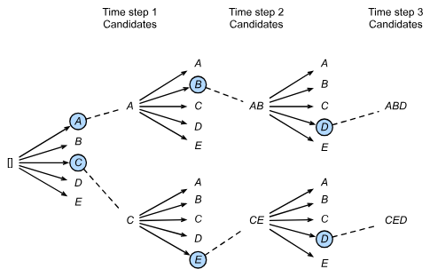
Decoding Strategies: Beam Search (2)
59

Slide 60
Decoding Strategies: Top-K Sampling
Top-k sampling is a technique that starts by picking the top-k tokens (k is the amount of words), and then chooses randomly from that set.
60

Slide 61
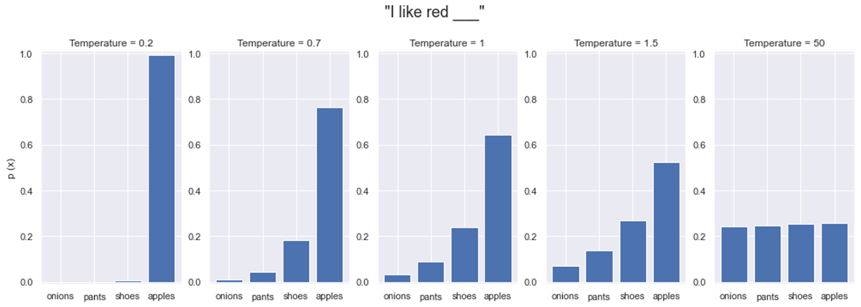
Decoding Strategies: Sampling with Temperature
Temperature can be used to control the randomness in language models during text generation.
It modifies the original probability distribution generated by the model, and we can sample according to the probabilities.
61

Slide 62
Decoding Strategies: Nucleus Sampling
Nucleus or top-p sampling is a technique that starts by picking a probability threshold, and then chooses randomly from the set of words that, when summed, reach that specified threshold.
62

Slide 63
More on Language Model Decoding
Beam search aims at approximating exact MAP sequence probability
Large beams explore many options, so you might expect better sequences
However, high-probability sequences are not always the best outputs
Humans prefer interesting, coherent, and slightly surprising text
Sampling strategies introduce stochastic exploration
Their alignment with human preference is often better than greedy/beam alternatives
Autoregressive models can be effective at exploring long context
E.g., caching strategies for keys/values used in masked self-attention
Recent alternatives propose strategies beyond auto-regressive decoding
E.g., diffusion language models
63

Slide 64
Overview
Introduction
Transformer-Based Encoder-Decoder Models
Decoder-Only Transformers and LLMs
More Details on Language Decoding
Strategies and Software for Using LLMs
Exercises
64

Slide 65
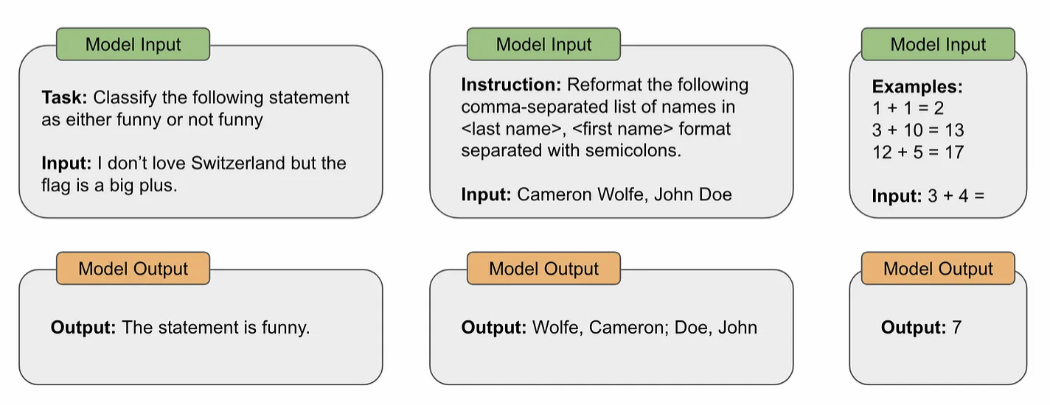
Prompting language models with instructions
65

Slide 66
Typical components of a prompt
Input Data: The actual data that the LM is expected to process (e.g., the sentence being translated or classified, the question to be answered, etc.)
Exemplars: One of the best ways to demonstrate the correct behavior to a LM is to provide a few concrete examples of input-output pairs
Instruction: Instead of (or in complement to) showing concrete exemplars of correct behavior in the prompt, we can just textually describe what to do via a detailed instruction
Indicators: Providing input to an LM in a fixed and predictable structure is helpful, so we might separate different parts of our prompt by using indicators
Context: Beyond the components described above, we may want to provide extra contextual information to the LM in some way. This can, for instance, include a role for the LM to play (e.g., assume you are a helpdesk assistant in the domain X)
66

Slide 67
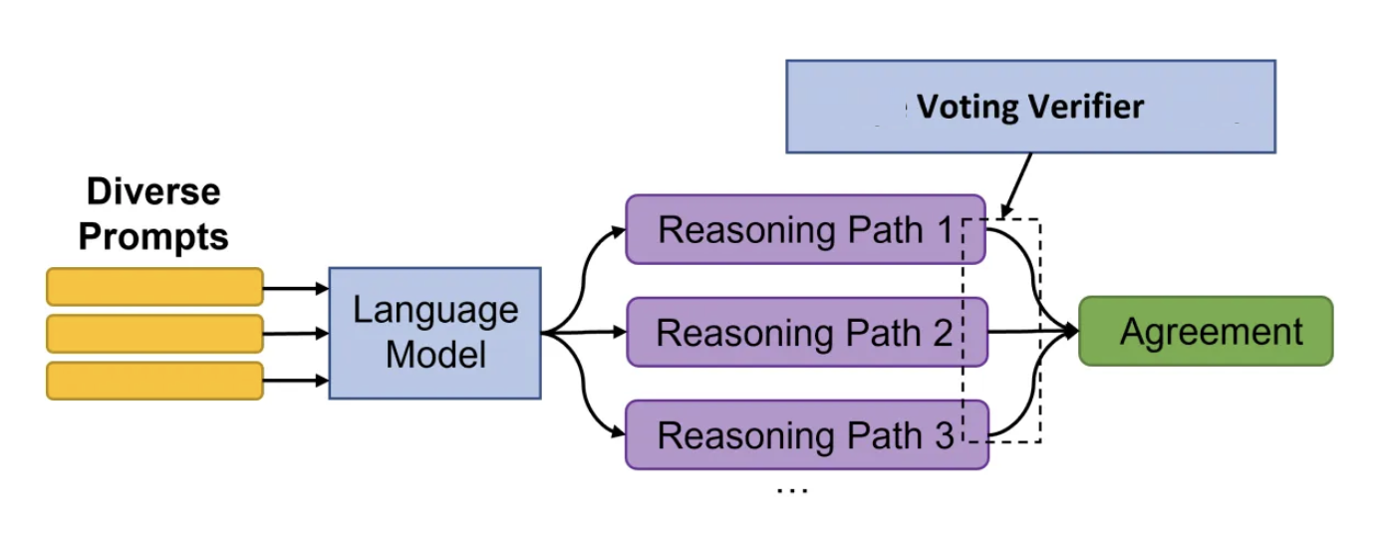
Tips for using LLMs
Several guides to “prompt engineering” available online
Start with simple instructions, ensure structure and clarity
Tweak the initial prompt, trying to be direct and aiming for specificity
Add few-shot in-context examples
Curate the few-shot examples, aiming for relevance and diversity
Consider the use of Retrieval Augmented Generation (RAG)
Consider the use of prompt ensembles
What if results are still poor:
Consider model fine-tuning (for smaller models)
Consider RAG and advanced prompting, e.g. chain-of-though, least-to-most, etc. (for larger models)
67

Slide 68
Knowledge augmentation and RAG
Key idea: Find knowledge in the form of relevant textual information (e.g., examples or in-domain details) to provide as extra context within a prompt
Allow the LM to access an external knowledge store
Provide unlimited memory to a LM by allowing the model to store and access prior information
Particularly interesting for dialogue systems and conversational information seeking
Explore information retrieval techniques (a.k.a., retrieval augmented generation):
Chunk in-domain textual documents into small parts
Produce an embedding for each chunk of text (e.g., through a BERT-like encoder model)
Store these embeddings in a vector database
Performing vector similarity search (based on the embeddings) to find relevant chunks of text to include in a prompt
68

Slide 69
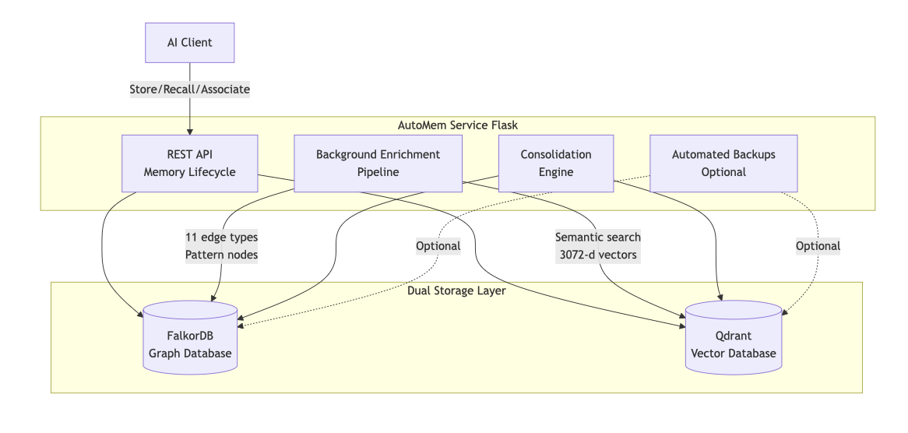
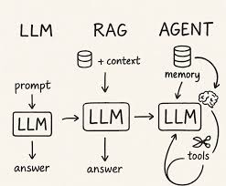
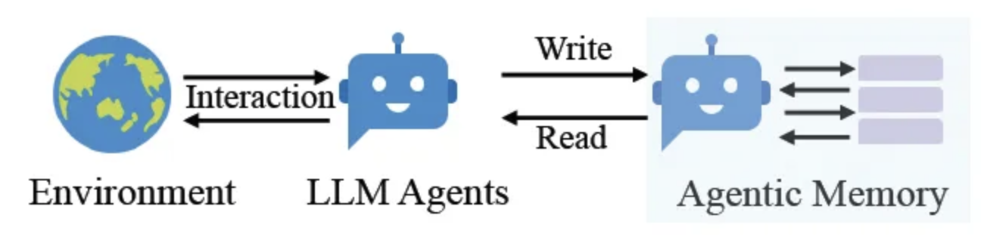
Knowledge augmentation and memory
Beyond RAG from a datastore, LLMs can interact with persistent and/or structured external memory mechanisms, executing read/write operations over time.
A-MEM, EverMemOS, AutoMem, ...
69

Slide 70
Software frameworks for LLMs
Serving (e.g., vLLM, SGLang, LMDeploy, …)
Focus on efficient serving of LLMs with low latency streaming for concurrent users
Often supporting KV caching (and KV compression) mechanisms
Often use batching and token-level scheduling to maximize GPU throughput
Often support multi-GPU deployments and model quantization for memory efficiency
Fine-tuning (e.g., Axolotl, HuggingFace TRL, ...)
Support for distributed training, checkpointing, efficient batching/multi-packing, etc.
Support for PEFT (Parameter-Efficient Fine-Tuning) through LoRA and variants
Specialized functionalities for Reinforcement Learning from Human Feedback (RLHF)
Developing complete applications (e.g., LangChain, LlamaIndex, Haystack, …)
Support for multiple LLM backends (open-source, proprietary, local, or cloud)
Support for prompt management and chaining, conversational/state memories, etc.
Integration with external APIs, datastores (e.g., vector search and retrieval augmentation) and knowledge sources
70

Slide 71
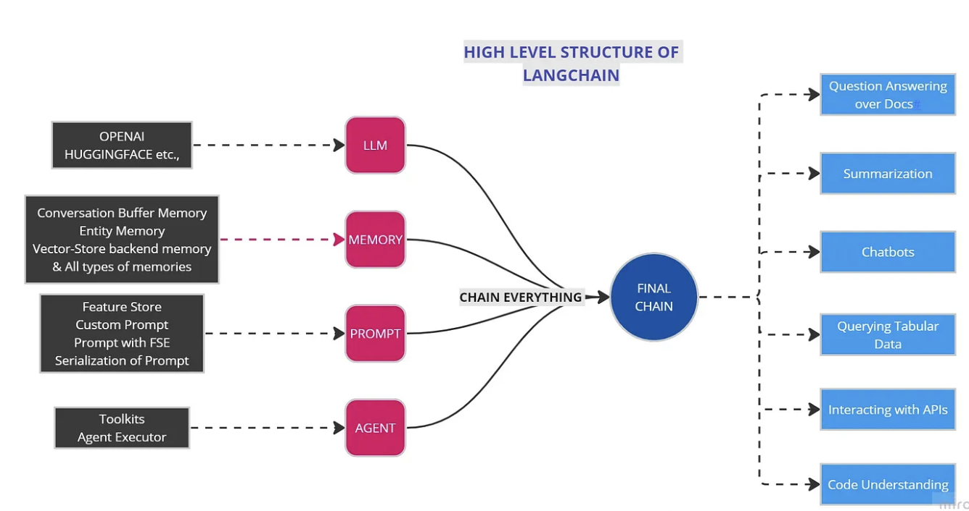

Applications Using LLMs
71

Slide 72
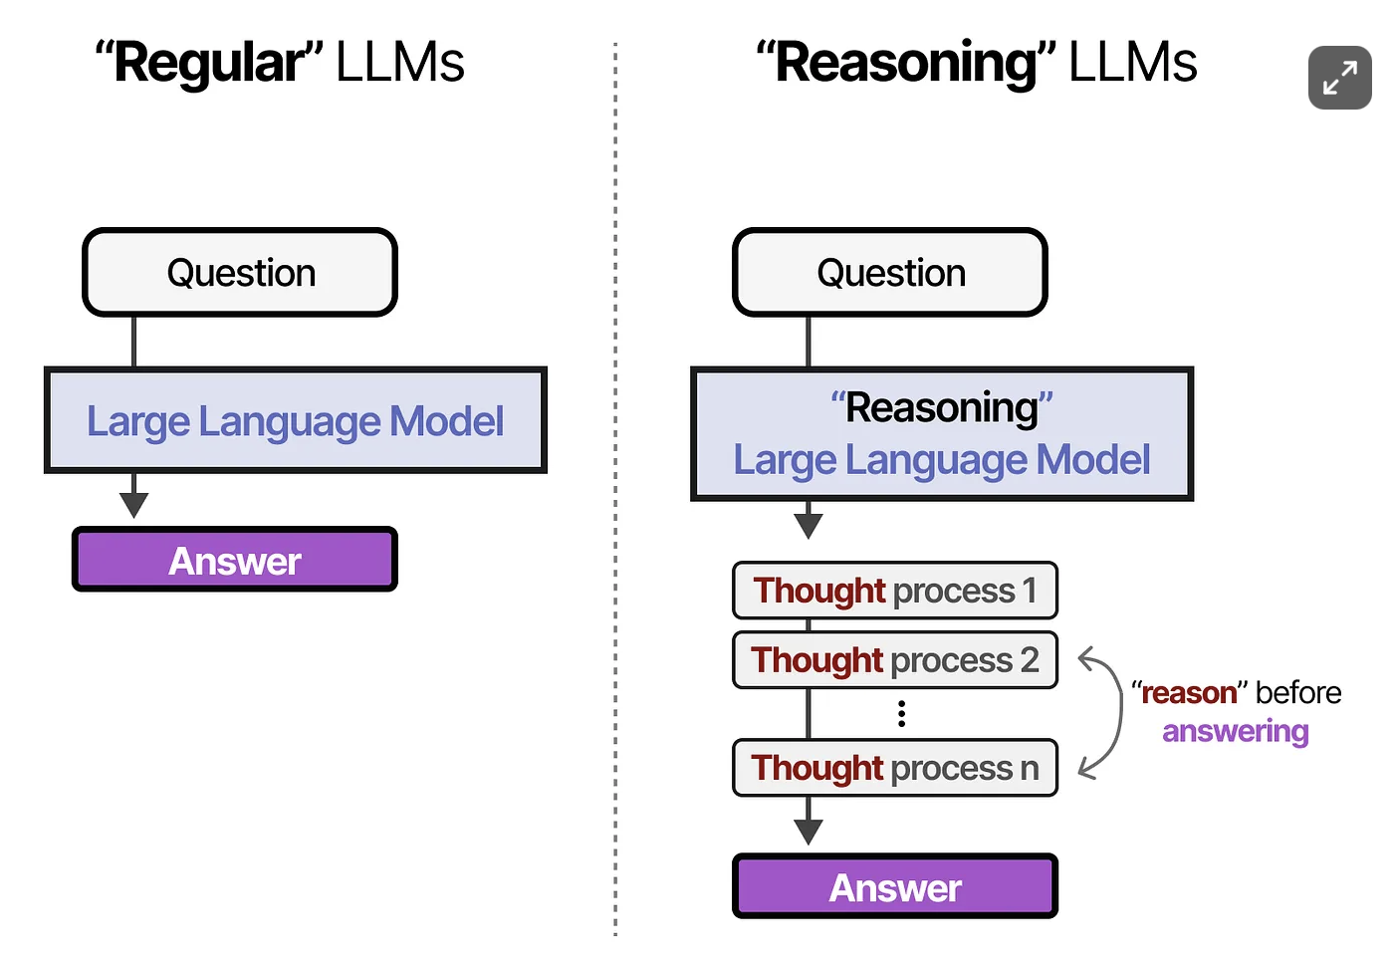
Current Frontier: Reasoning LLMs
A Visual Guide to Reasoning LLMs
https://newsletter.maartengrootendorst.com/p/a-visual-guide-to-reasoning-llms
72

Slide 73
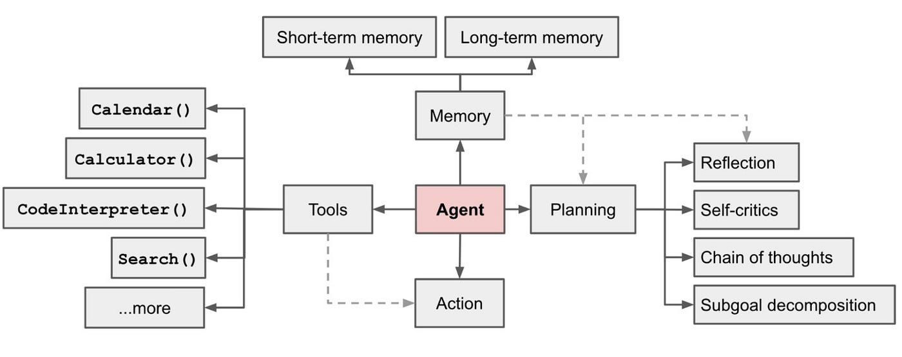
Current Frontier: LLM Agents
A Visual Guide to LLM Agents
https://newsletter.maartengrootendorst.com/p/a-visual-guide-to-llm-agents
73

Slide 74
Exercise Time
https://huggingface.co/learn/cookbook/en/advanced_rag
74

Slide 75

Thank you!

